Slide 1


Meeting Electricity Demand in Rural India
-Ritika Singh

Slide 2
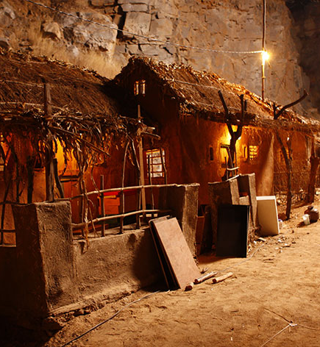
Introduction
India began using regional, state-based grid management systems for electricity in the 1960s
While there is affordability of power and a steady industry growth since, power reserves fail to reach all the nooks and corners of a vast India
As Asia’s third-largest economy, one of the many things holding the country back is its power shortage
Indians with electricity are facing blackouts daily, resorting to using diesel-run generators or inverters to cope

Slide 3
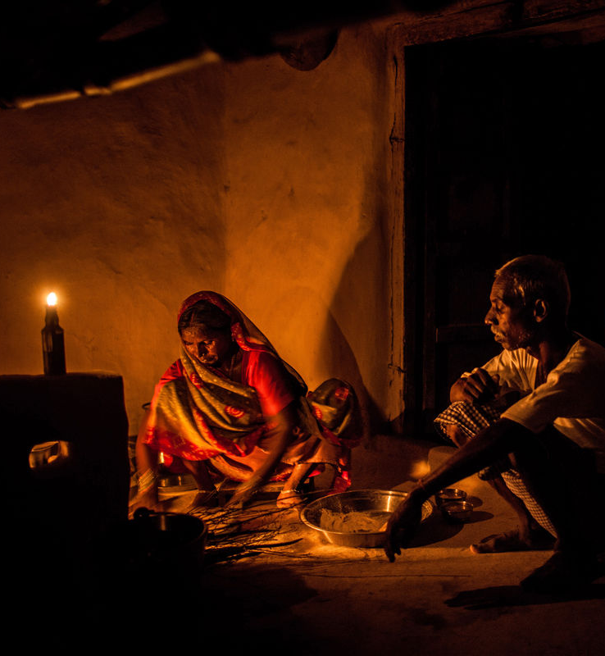
Problem
According to official data, only 1,417 of India’s 18,452 villages, or 7.3% of the total, have 100% household connectivity, and about 31 million homes are still in the dark.
Majority of households/shops receive less than 6 hours of uninterrupted supply of electricity in a day
Irregular voltage problems causing damage to appliances
People use diesel run generators, kerosene lamps
Kerosene fumes from lamps is deemed to have adverse health effects

Slide 4
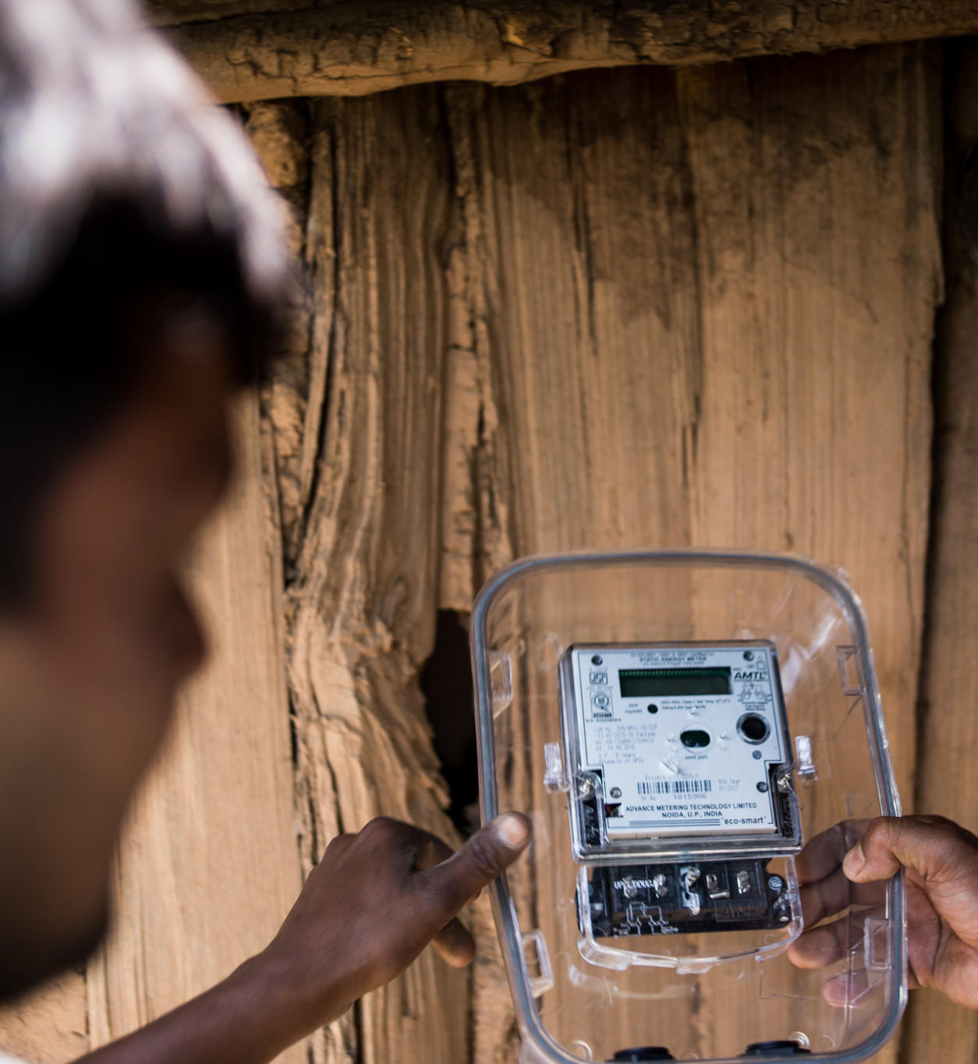
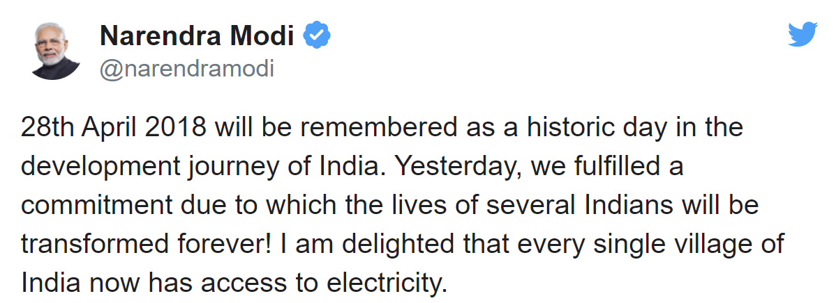

What is government doing?
The government deems a village “electrified” if power cables from the grid reach a transformer in each village and 10% of its households, as well as public places such as schools and health centers, are connected.
Electrification is a three-step process:
The first is to extend the infrastructure to the village
The second is to connect the household
The third, the most challenging, is to ensure reliable and affordable supply on a sustained basis.

Slide 5
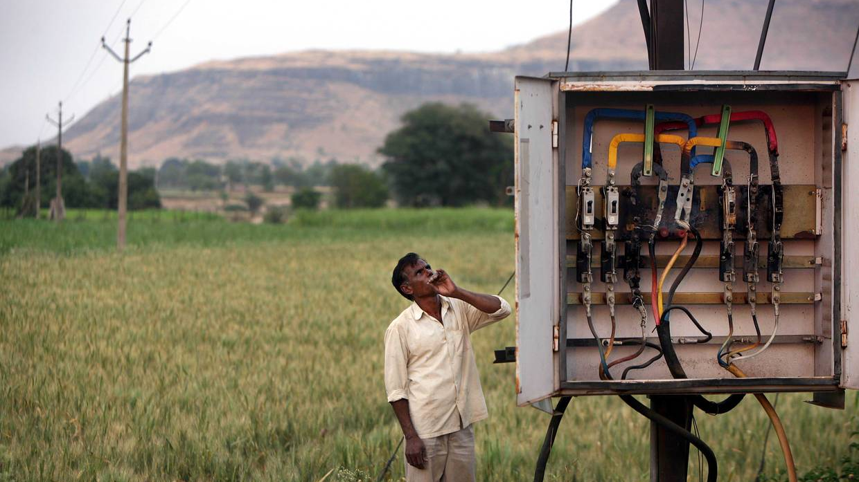
Addressing the challenge
Governments and development finance institutions need to:
Develop least-cost electrification strategies
Identify micro-grid sites at scale for country-wide electrification tenders
Cross check survey results with earth observation data to improve planning quality

Slide 6
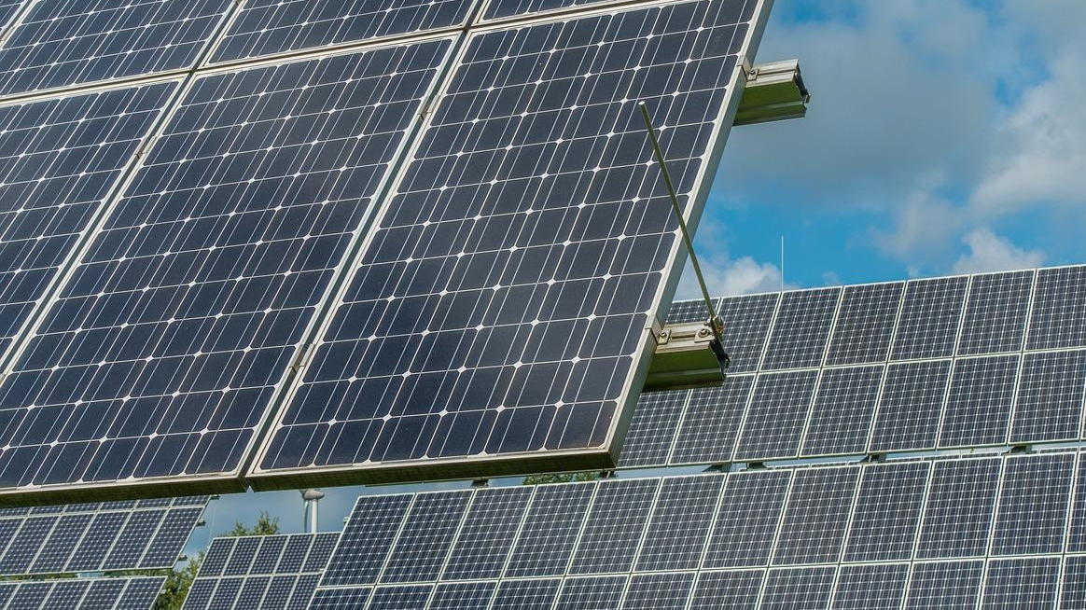
Addressing the challenge
Micro-grid developers plan, build and operate micro-grids in off-grid, rural communities. They need to:
Find suitable sites in a scalable way
Access project funding
Have a clear decision-making tool that fits into their existing work-flow

Slide 7
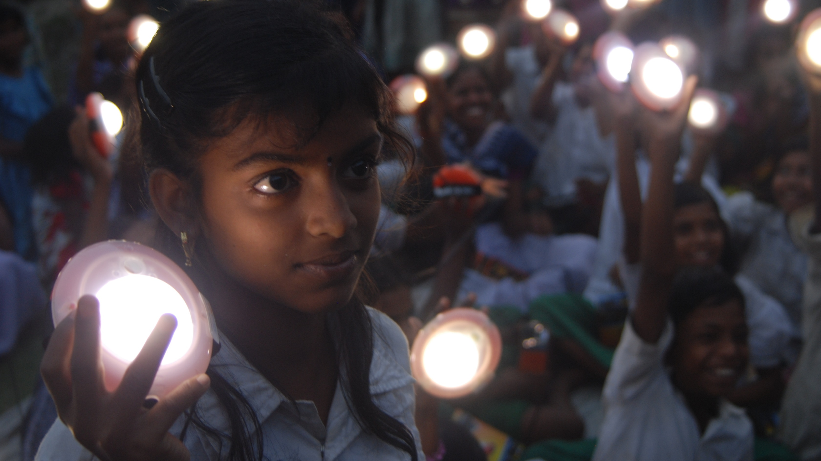
Addressing the challenge
Off-grid energy product companies (Solar Home Systems, solar lanterns) are looking to expand into new areas. They need to:
Curate market intelligence on off-grid markets for expansion
Locate underserved areas within existing markets
Plan supply chains based on expected demand

Slide 8

Addressing the challenge
Investors are looking for financially viable energy access projects. They need to:
Assess the risk of investments in specific micro-grid projects
De-risk investment by providing information and data about potential sites

Slide 9
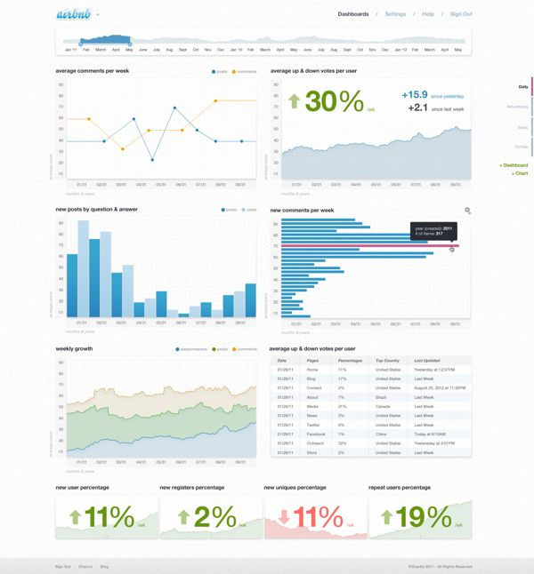
Sample
Solution
A dashboard which fulfils these needs by answering questions related to the supply and demand gap for business units and households
Creation of Cost-Impact metrics which can be consumed by the end users at various levels such as:
KW-hr/SqKms(Projected area wise electricity consumption),
Rupee/SqKms(Projected area wise revenue)
Feasibility of off-grid options such as (Solar Home Systems, solar lanterns)

Slide 10
Appendix
Data: https://dataverse.harvard.edu/dataset.xhtml?persistentId=doi:10.7910/DVN/1ZNLUY
Facts about electricity in Rural India: https://www.statista.com/topics/5193/electricity-in-india/
Current state of electrification in India: https://www.forbes.com/sites/suparnadutt/2018/05/07/modi-announces-100-village-electrification-but-31-million-homes-are-still-in-the-dark/#6ed9246363ba
https://business.esa.int/projects/village-data-analytics
https://www.livemint.com/Opinion/nrgFBVsILzEtbJf7pwfH3H/The-problem-of-lack-of-rural-electricity-demand.html
https://aif.org/rural-electrification-in-india-problems-progress-and-the-power-of-citizens-media/

